Slide 1
Robotics Project
By Michael Schmid and Daniel Robles

Slide 2
Challenges:
Only had two in our group instead of the normal three
Working remotely because of the pandemic and having to quarantine
Fine tuning of the coding to get the robot to work as instructed

Slide 3
Roles:
Michael:
Did most of the writing for the system design document
Developed the algorithms
Wrote the flowchart
Daniel:
Filled out the charts within the system design document
Had the robot
Recorded the robot performing tasks
Collective:
Worked on coding for robot
Reviewed each other’s work

Slide 4
What have you learned about software engineering?
First and foremost, that it is no easy task and requires time and effort
That so much work is involved from basic planning, to the algorithm, to the flowchart, to the coding, etc.
How to use block coding to control a robots movements, lights, and what it can say

Slide 5
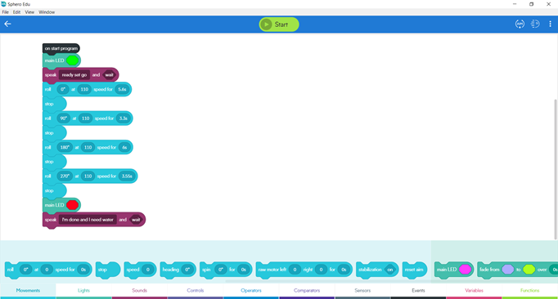
Block code for Endurance Sprint

Slide 6
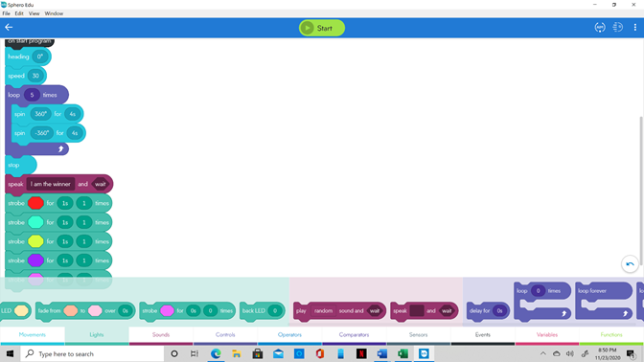
Block code for Accuracy Sprint

Slide 7
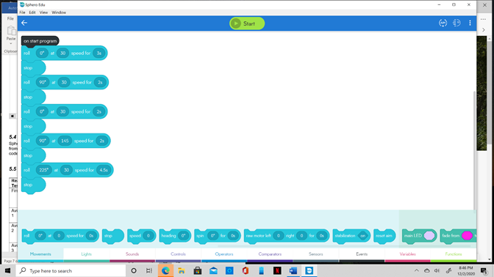
Block code for Agility Sprint

Slide 8
What would you do differently?
Having the chance to we would attempt to go to the campus for all three attempts at the robot running the course
If it were possible to get another groupmate just to experience how it would be to have three people in a group
If the project was started again the roles would be switched around just to try out each role

Slide 9
Videos:
Endurance pt. 1
Endurance pt. 2
Accuracy pt. 1
Accuracy pt. 2
Agility

